Slide 1
EENG 284 Lab 08
Mod 10 Counter
Notes:
Usually the <title of the lab> is what will be called the “System” through the rest of this document

Slide 2
Lab Objectives
The objective of this lab is to design a mod10 counter that you will use as part of a digital stopwatch to represent the digits of a stopwatch.

Slide 3
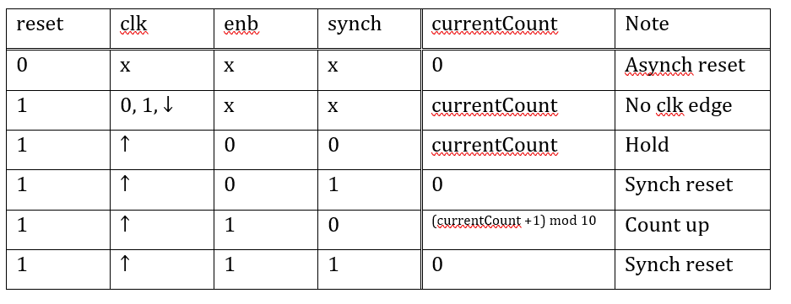
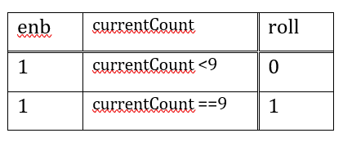
Mod 10 Counter
When enabled, counts up from 0 to 9 and then back to 0.
When it counts up from 9 to 0, we say that it rolls over.
A roll over is accompanied by assertion of an output called roll.
Notes:
Replace <System> with the name of the

Slide 4
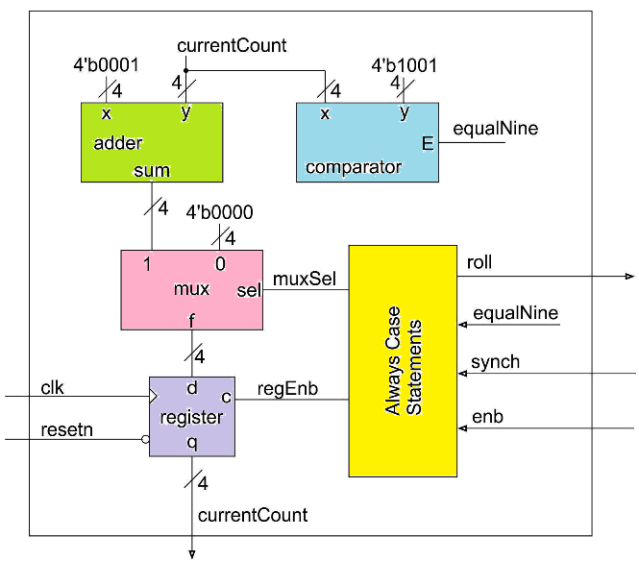
System architecture
You have been provided with the building blocks shown here.
You will wire them and need to define the logic inside the always/case.
Roll logic is combinational
Notes:
Talk about the input is transformed into the output using the system architecture

Slide 5
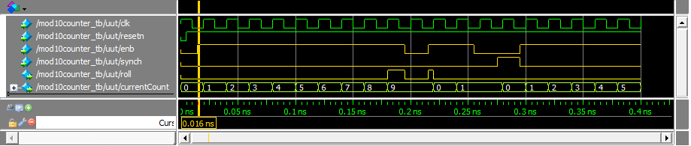
Simulation
Work simulation by hand:
Use Do file to setup traces of your simulation
Run simulation, should equal worked values

Slide 6
Synthesis
No synthesis this week.

Slide 7
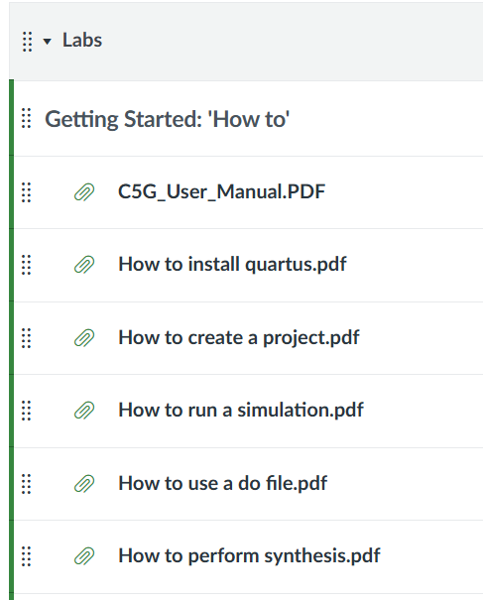
Deliverables
Mod10 Counter Verilog
Complete Table 3 and Table 4.
Verilog code for the body of the datapath module.
Timing diagram of the mod10counter in Questa using the testbench with do file.
Do file. Refer to “How to use a do file” on canvas in the Lab module

